Slide 1

Self-Introduction
Johnny Huang
Jan. 29, 2016

Slide 2
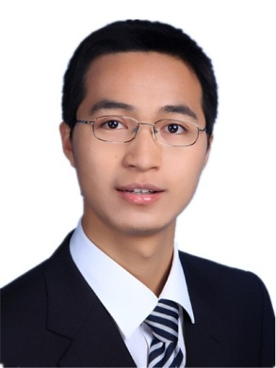




About Me
Work Experience
Senior software engineer
Arris & Motorola 2013/1 – Present
Software engineer
ZTE Corporation 2011/5 – 2013/1
Education
Master of Software Engineering
Shanghai Jiao Tong University 2008/8 – 2011/3
Bachelor of Electronic Information Engineering
Donghua University 2004/9 – 2008/6

Slide 3
Self Assessment
Ability to solve problem
Group golden bug hunter 2014
“Bullet subtitle on STB” Best award in company Hackthon 2015 (Top 1 in 13 prototypes)
Creative
3 US patents in STB field (First inventor)
Delivery high quality code
Version Control Lead (SVN system)
Code reviewer in 3 review groups (dev tool, KATT system, Diagnostics)
Skill in communication: both Chinese and English
5 years experience in international company
IELTS: 6
CET 6

Slide 4
Project Experience
KreaTV STB platform
Top STB platform market in Europe & US, was belong to Motorola Mobility Home, and acquired by ARRIS in May, 2013
Based on Linux, C++(backend), java script(frontend), python(test)
Comprised by Media core, Media add-on, application environment, and Common Software.
Common software is in change of the common modules in platform, include Diagnostics, Storage management, time management, log, information, make system and autotest system
Responsibility
Unit tests based on Google Test Framework, autotest cases developing and maintaining(based on python)
STB monitoring and management module(Diagnostics), log module(Boxlogclient),
Software version control
Bug fixing, code review.

Slide 5
Project Experience (cont.)
GSM Memory Data Base Developing and Optimizing
distributed database
provides base station configuration management and user data processing and storage
Responsibility
Developing and optimizing DSP resources sharing algorithm -- DYNPCU on DBM, which coordinates the number of cell on DSP according to service load, it can also be coordinated to specific DSP by manual.
Software testing on GSM base station software.(Python script, Visio Studio 2005) , developed a tool called CSQL for Database table autotesting that based on open source parsing tool--(PLY).
Designing data base tables overload management module via primitive provided by plat, which is called by DBI.
GSM software testing.

Slide 6
Experience on Code Quality Assurance
Predefine (requirement-> ePM)
Architecture (-> KARB review group)
Interface define (-> KIRB review group)
Coding Style
can be read easily(without comments, only copyright)
Unit test
Google Test framework (based on XUnit)
Review
Shipped by group(>= 3 members shipped)
Auto test (run automatically as soon as code committed)
4 Level test(basic, feature, performance, 1700+ cases total)
Smoke test before committing
Verified by test team after committing

Slide 7
Good (What can I offer)
Experience in top international company delivery high quality products
different perspective (Tools, methods, process)
Strive for high quality, better process
Creative
Always be ready to learn

Slide 8
Need to Improvement
Skill in consultant (presentation)
Knowledge base
Field
code quality assurance
Balance for time & quality

Slide 9

Thanks for your time!
Glad to have this opportunity to present

